Slide 1
ChefPal
Shahir Ghani
Malena Bashar
Dymytriy Zyunkin
Daniel Samojlik
Amanda Phan
Michael Fong
Malak Khalifa
Aswathy Aji
Azim Khan
Nirav Patel

Slide 2
A little about ChefPal
(provide brief description/summary)

Slide 3
Targeted Audience (Who is it for)
Take from report 1?
Talk about who we want this app to target and why it is useful for them

Slide 4
Features and Uses (What is it for)
Talk about the different ways the app can be used
Quick recipe finder
Input in available ingredients to generate recipes that can be made
Casual Recipe Finder
Search for recipes to make through a keyword search
Convenience
Find nearest grocery stores

Slide 5
What’s Next...

Slide 6
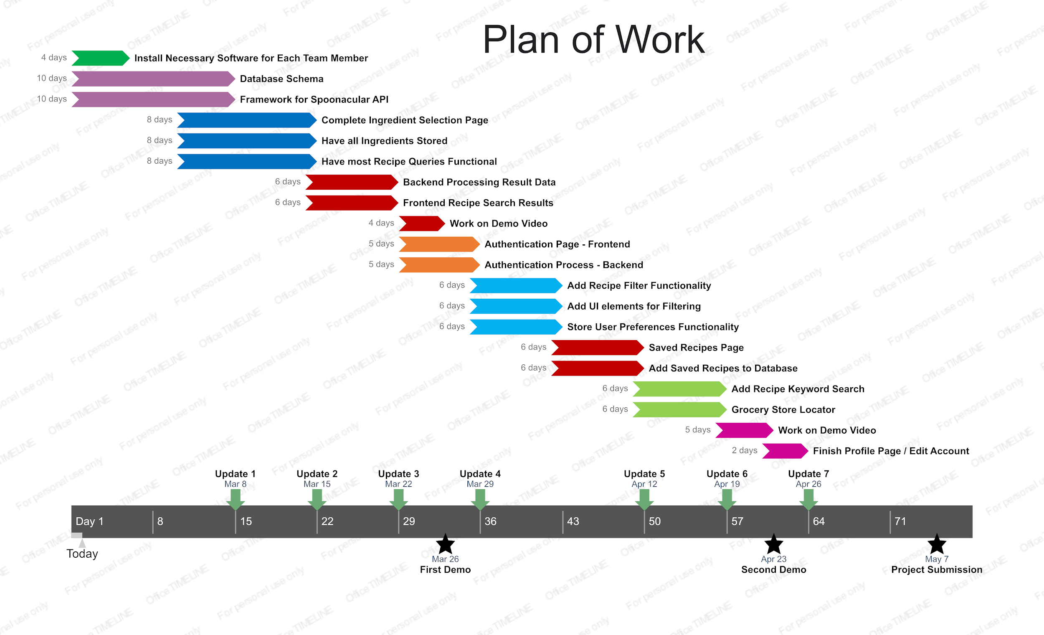
Roadmap

